Slide 1

Data Analysis Toolkits

Slide 2
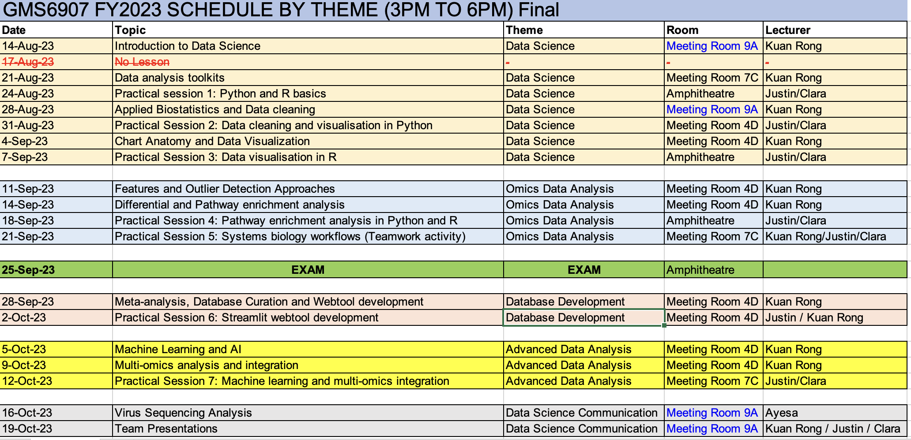
Some changes in venue

Slide 3

Graphpad Prism
Efficient software to produce publication quality figures in a short time
All graphs are customizable and magic wand function allows building of graphs with similar layouts
Allows building of layouts so that multiple plots can be visualised
User-friendly interface

Slide 4
Getting started with Prism
https://www.graphpad.com/series/getting-started/
Can also use their tutorial datasets to explore the features of Prism

Slide 5

Live demonstration
Graphpad Prism

Slide 6
Introduction to GitHub

Slide 7
What is GitHub?
Web-based
Code hosting platform for version control and collaboration
Allows users to store and download files, codes, teaching materials (Almost functions as a Dropbox!)
Can also be used as a platform to share files and codes
Increasingly used as a platform for online resumes and e-books!

Slide 8
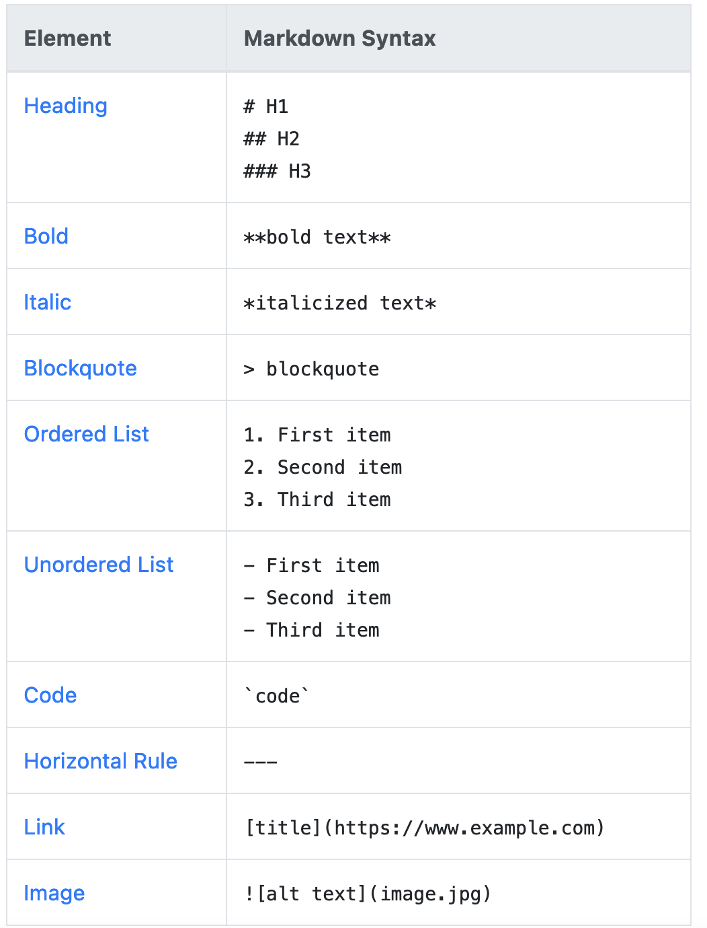
GitHub uses the markdown language
https://www.markdownguide.org/cheat-sheet/

Slide 9
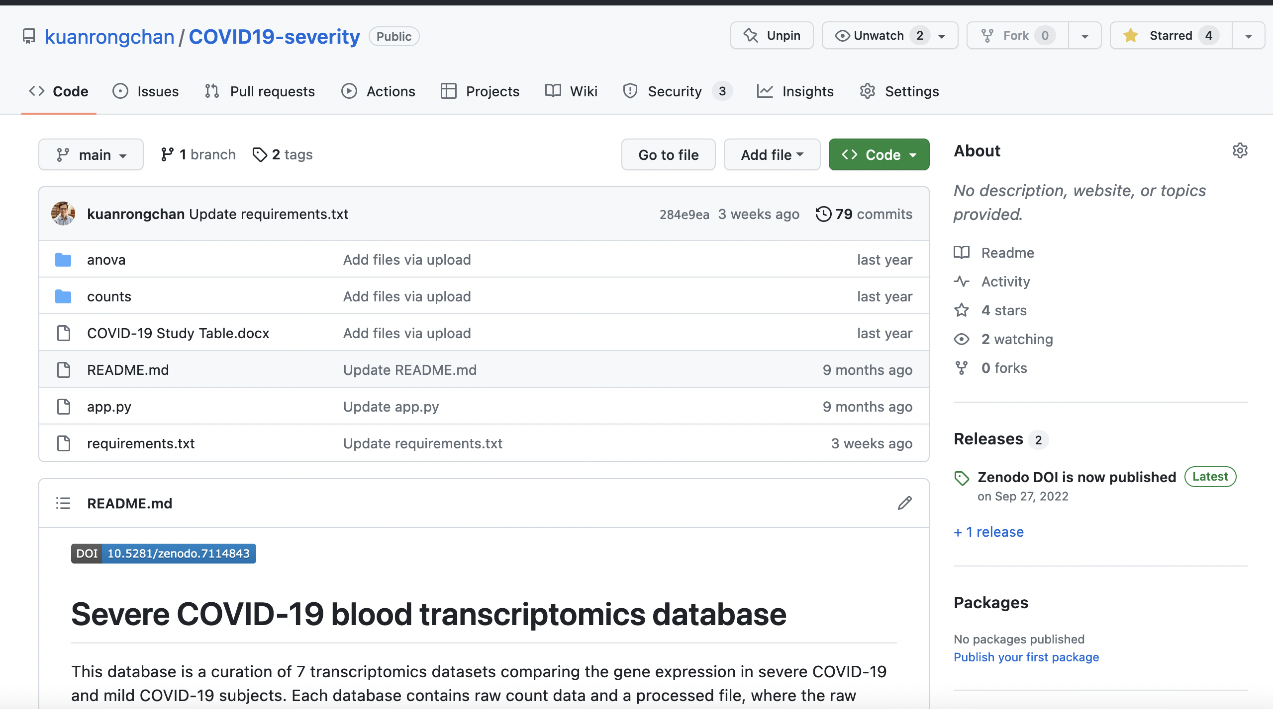
Depositing datasets with GitHub for scientific publications

Slide 10
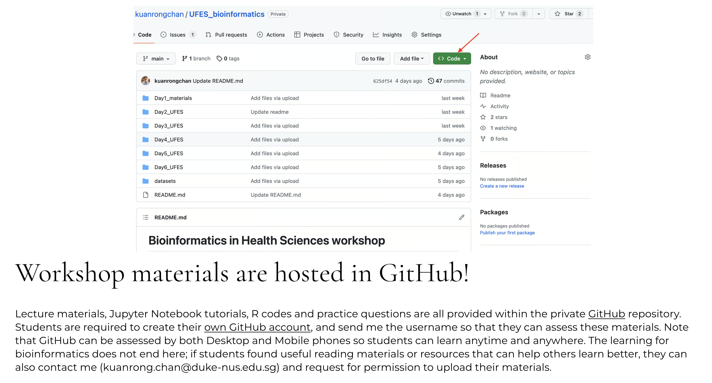
Lecture materials are hosted in a private repository!

Slide 11

A short live-demo
https://github.com/

Slide 12
Introduction to Python

Slide 13
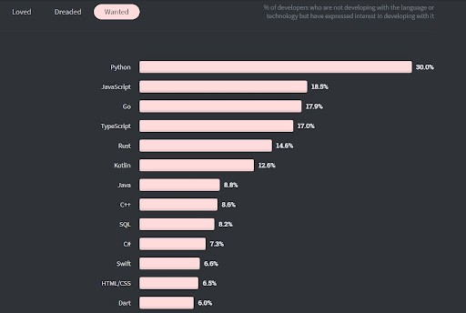
Stacked overflow suggests Python is among the top wanted languages

Slide 14
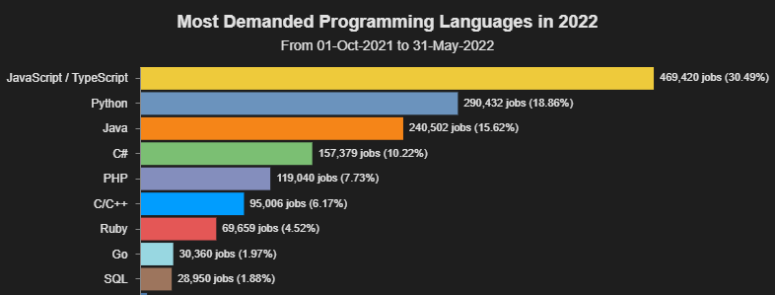
And also the most demanded

Slide 15
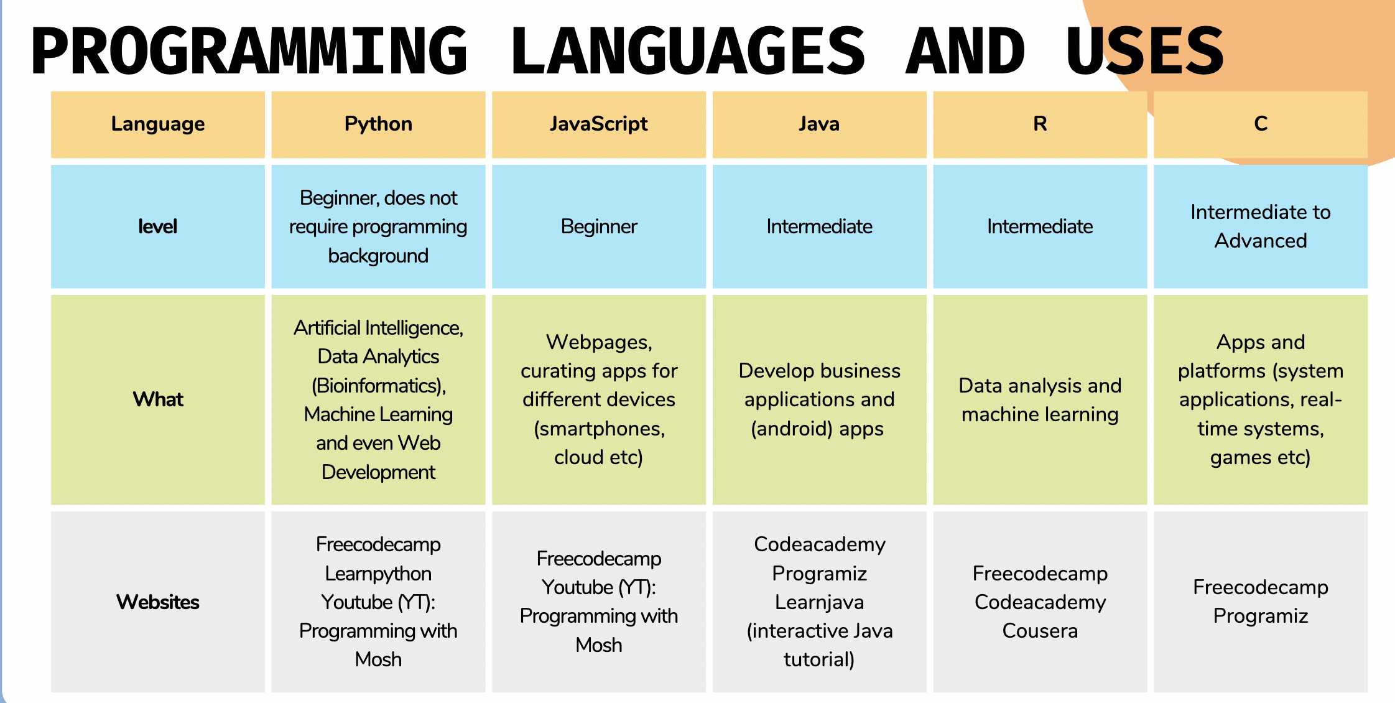

Slide 16
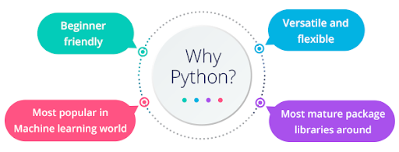

Slide 17
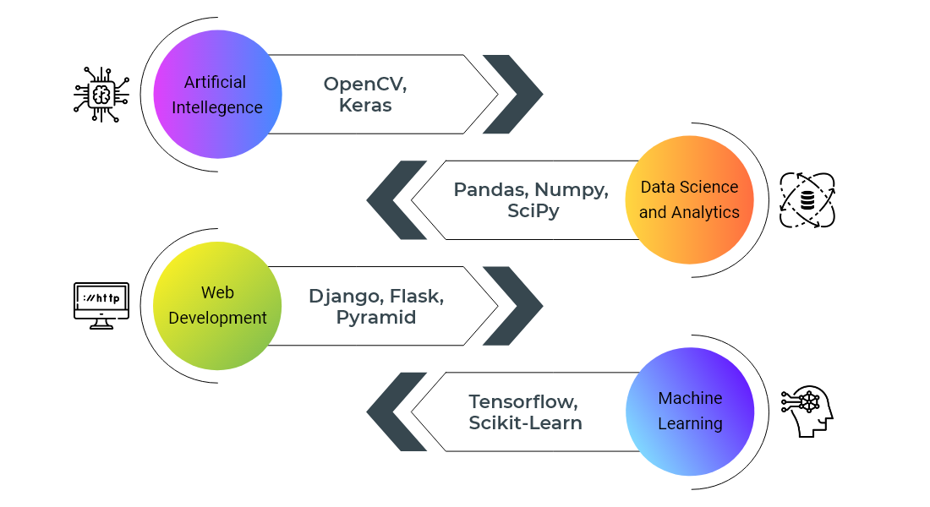
Python libraries for multiple applications

Slide 18
Other advantages of Python
Python is easy to understand and write.
Possible to do web development (presence of frameworks), server deployment, scientific modeling, and many others.
Python libraries allow you to do a variety of operations and actions without having to write any code.
Python is backed by a vibrant community that is always willing to help with any programming challenges
Can develop multi-protocol networking applications.

Slide 19

Python is better than Excel for data analysis
https://medium.com/omics-diary/is-learning-python-worth-the-effort-or-is-microsoft-excel-adequate-f8e49eac74fd

Slide 20

Wonderful language for webtool development

Slide 21
Introduction to R

Slide 22
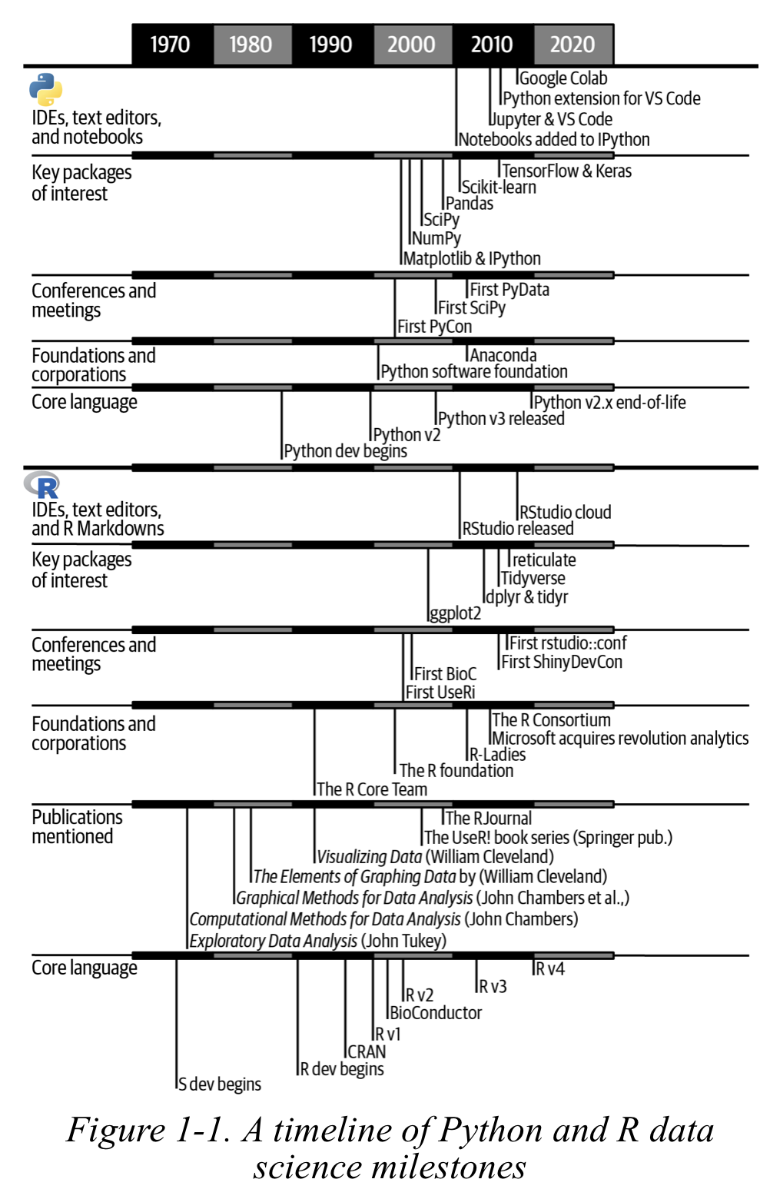
R has the best libraries for statistics and data visualisation

Slide 23
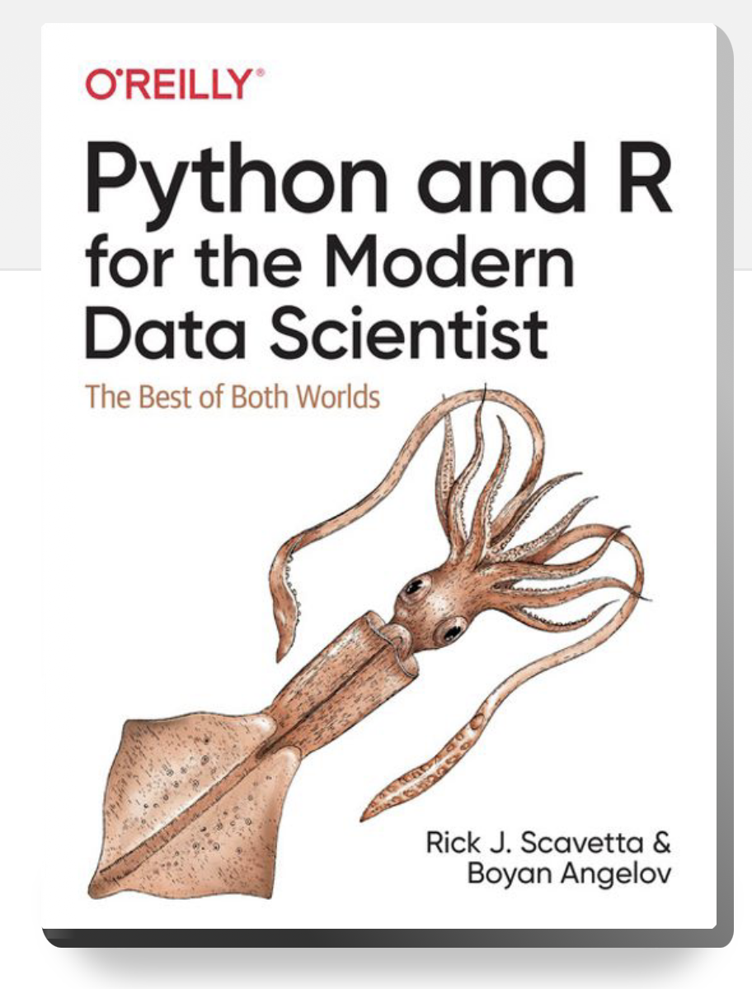
Python and R can co-exist

Slide 24
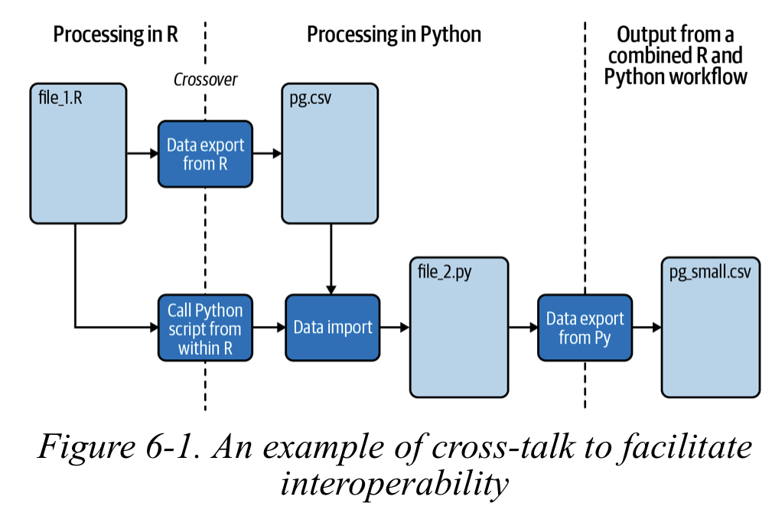
Being able to use Python and R interchangeably will users to enjoy best of both worlds

Slide 25
Python resources

Slide 26
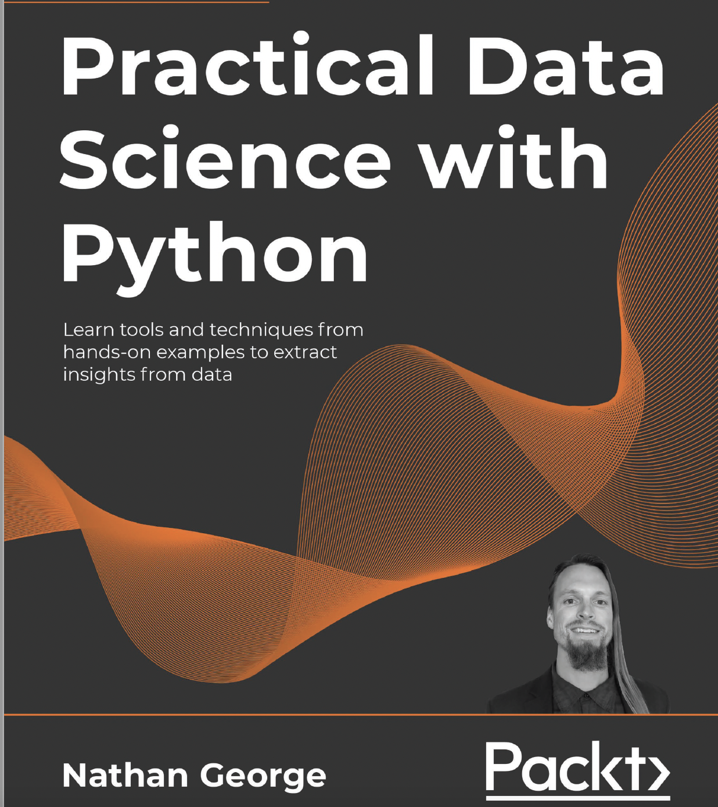
Amazing book for data science

Slide 27
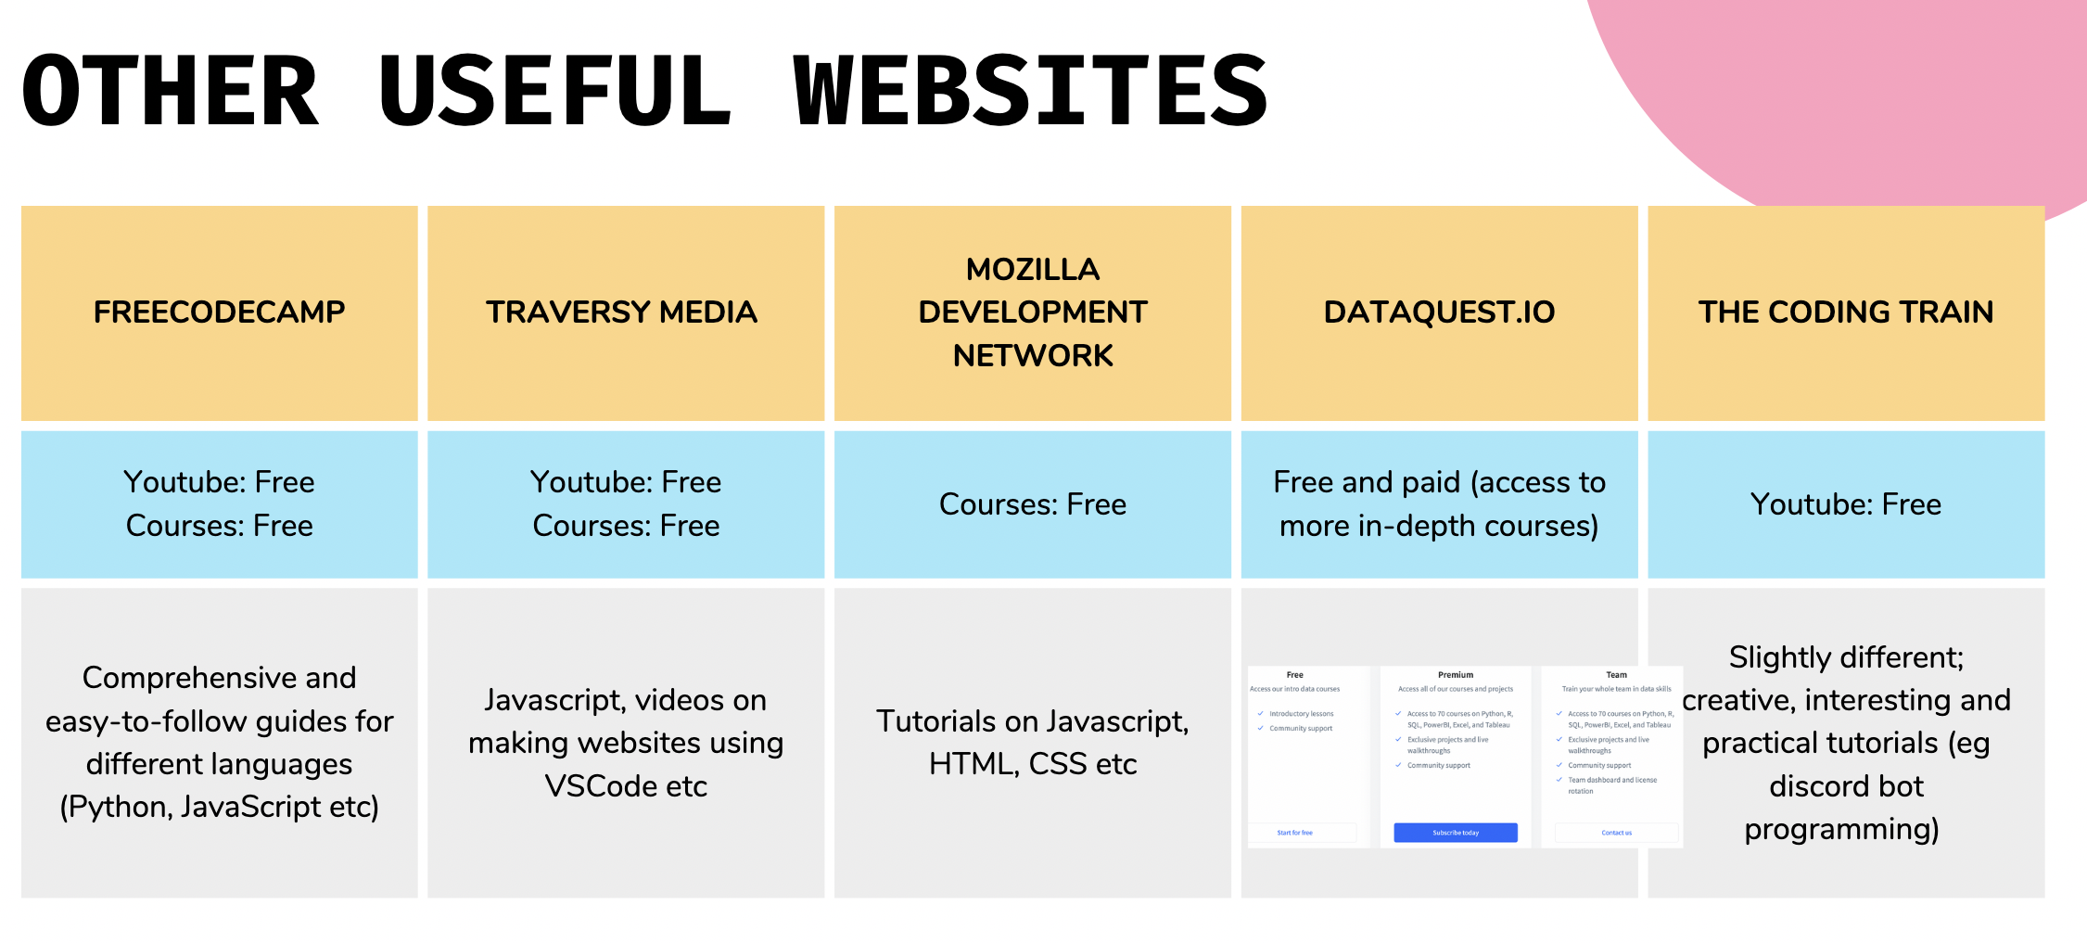

Slide 28

To learn more about the Python language

Slide 29
Getting started with Python

Slide 30
Downloading Jupyter Notebooks
Visit
Visit the Anaconda website.
Download
Download the 64-bit Graphical Installer based on your computer OS.
Open
Open the package after download, and follow the instructions to download Anaconda into your computer.
Launch
Launch the Anaconda-Navigator by clicking the icon. For Mac users, the icon should appear under the “Applications” tab
Launch
Launch JupyterLab, choose Python3 notebook, which will eventually direct you to the notebook server’s remote server

Slide 31
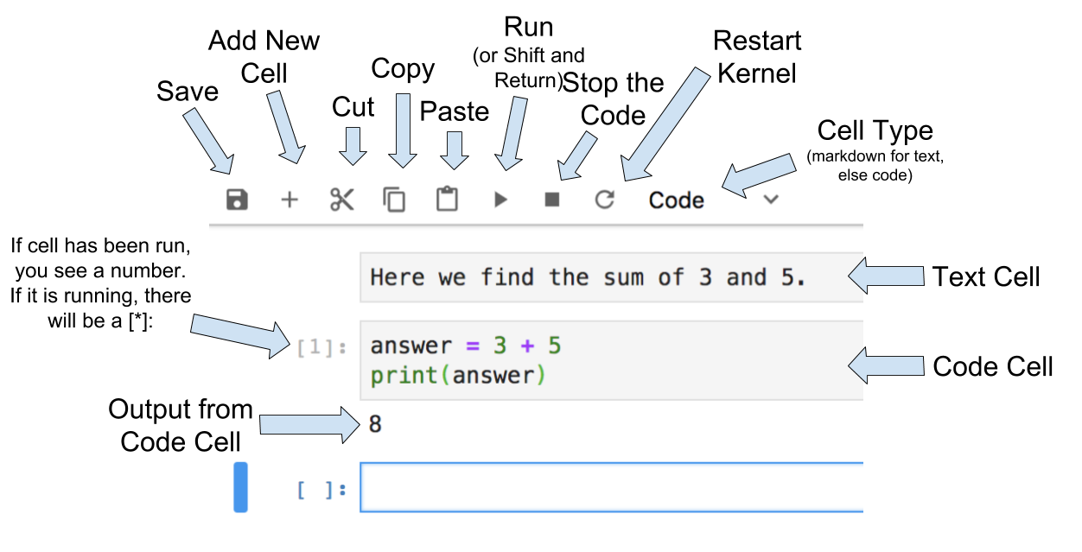
Anatomy of Jupyter Notebooks

Slide 32
Let’s try to key in some Python codes in Jupyter Notebooks!
Basic introduction

Slide 33
Getting started with R

Slide 34
Downloading R and RStudio
Download R (https://cran.r-project.org/)
Download RStudio (Desktop) IDE (https://posit.co/download/rstudio-desktop/)
Follow the instructions to install in your computer (https://rstudio-education.github.io/hopr/starting.html#how-to-download-and-install-r)
Open RStudio to work with R commands

Slide 35
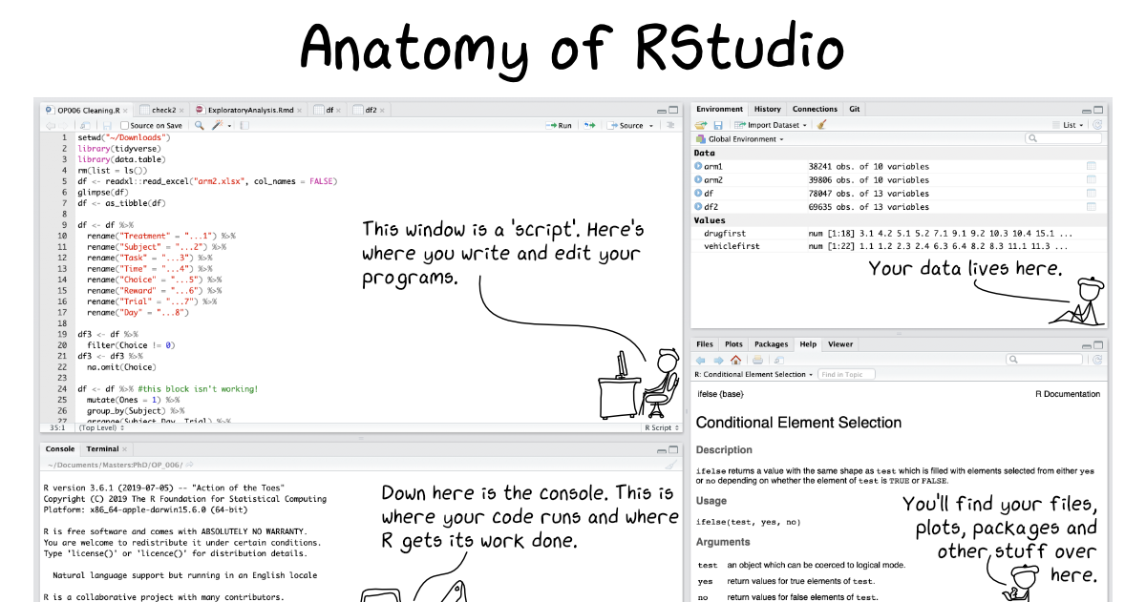

Slide 36
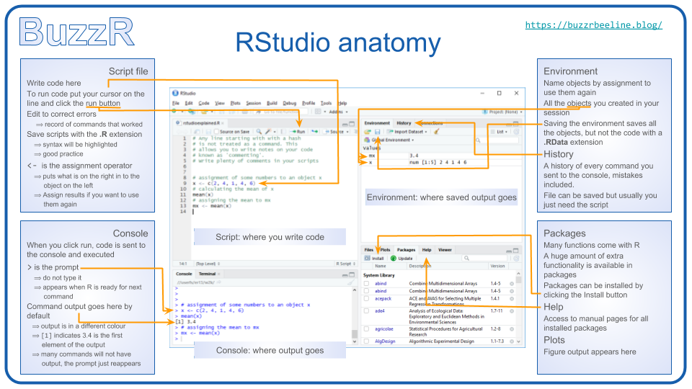

Slide 37
Manipulating tables with Pandas

Slide 38

Introduction to Pandas
Pandas documentation at: https://pandas.pydata.org/docs/pandas.pdf
A nice summary of the Pandas commands are also available at: https://medium.com/towards-data-science/30-very-useful-pandas-functions-for-everyday-data-analysis-tasks-f1eae16409af

Slide 39
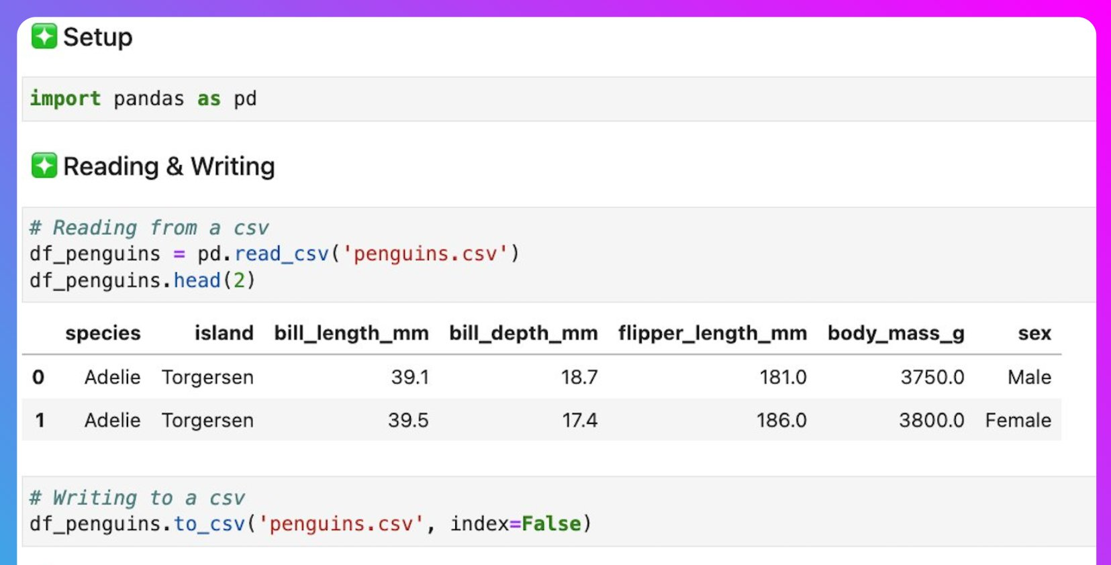
Reading and writing csv files

Slide 40
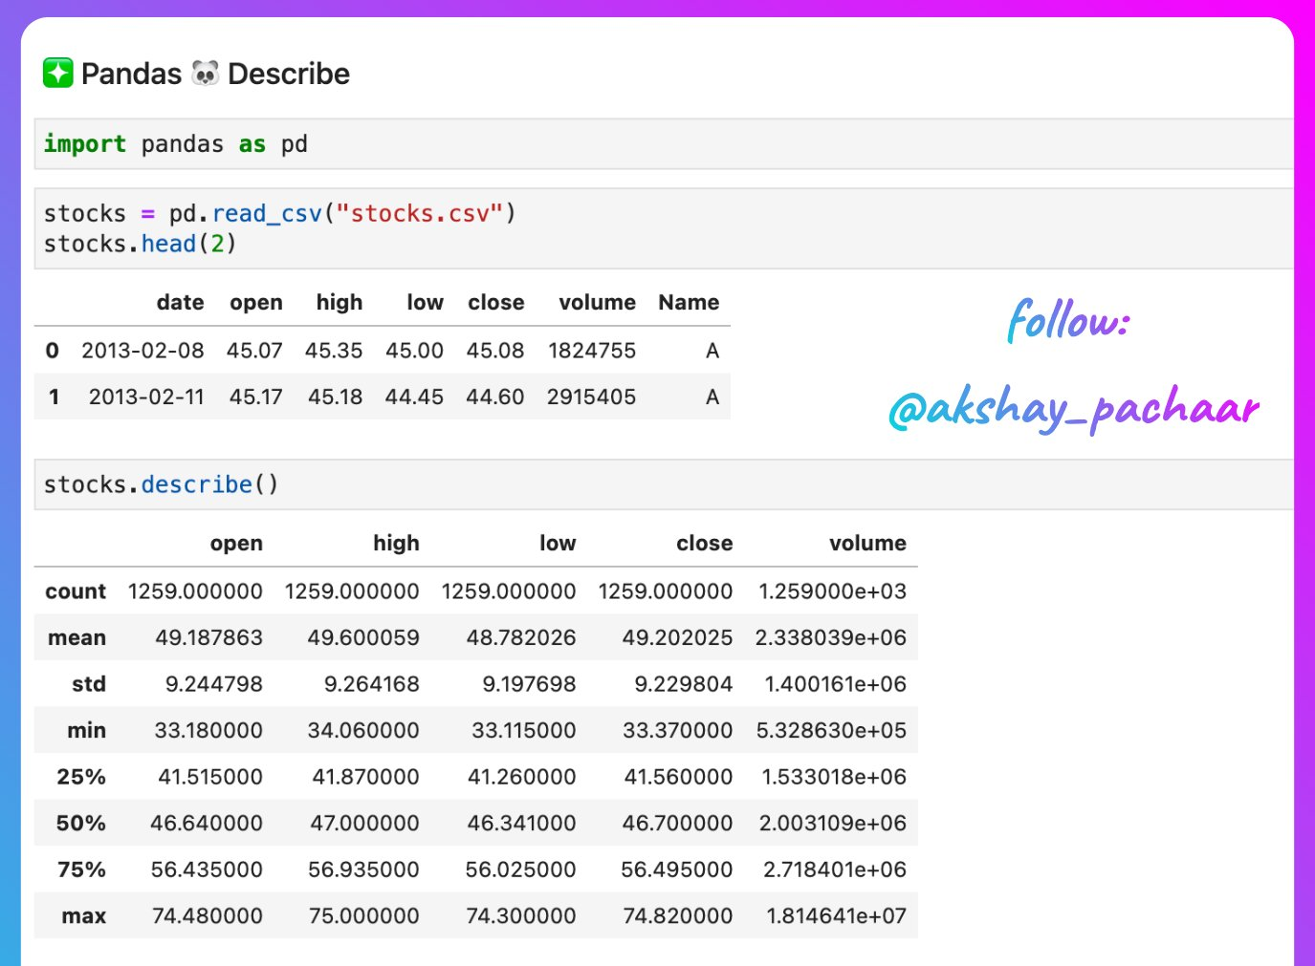
Describe functions allow you to see statistics

Slide 41
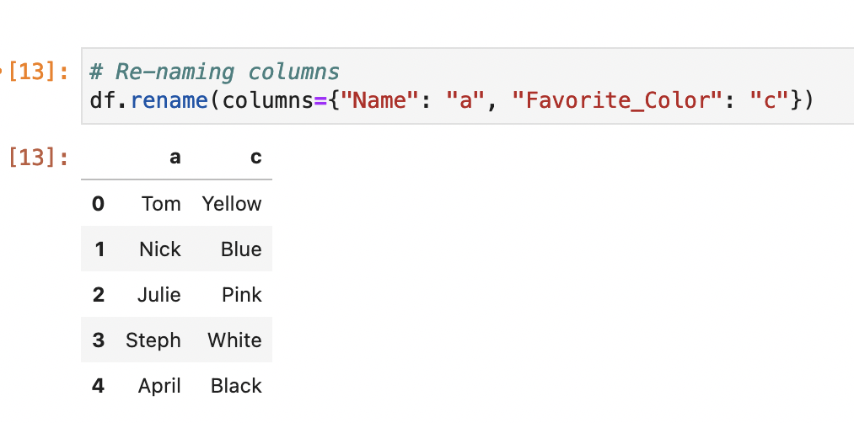
Renaming columns in Pandas
df.rename can allow users to change the column names easily

Slide 42
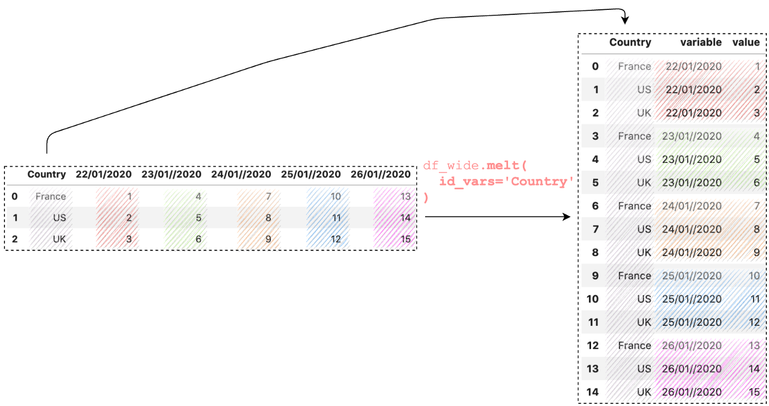
Pivot table with df.melt
df.melt converts a wide to a long format, similar to pivot table function in Excel

Slide 43
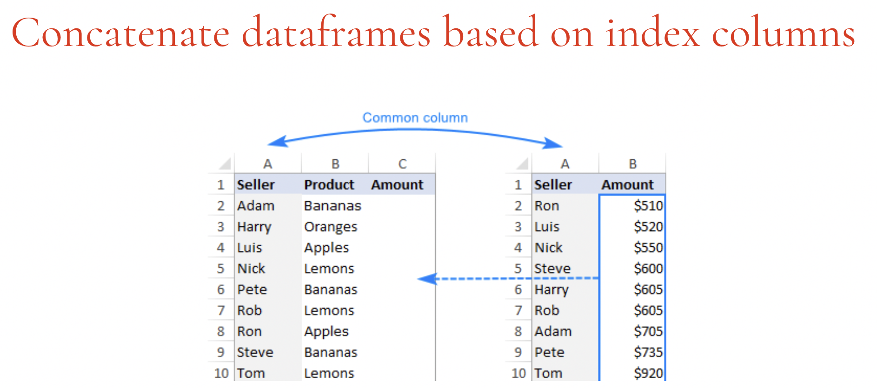
Concatenating data with Pandas
https://www.kuanrongchan.com/concatenate

